Slide 1
A Security Architecture for 5G Networks
Reshma Joshy
Class No.:49 B-tech CSE
Dept of MACE, Kothamangalam
29th September 2018

Slide 2
CONTENTS
A Security Architecture for 5G Networks
Introduction
Objectives
Main Concepts of Architecture
Process Steps
Security Architecture details
Analysis
Use cases
Conclusion

Slide 3
INTRODUCTION
A Security Architecture for 5G Networks
New technologies such as Softwarisation and Virtualisation
Network slicing , NFV and SDN
New types of trust relations in 5G
Why a security architecture?
Limitations of previous network generation security architectures

Slide 4
OBJECTIVES
A Security Architecture for 5G Networks
Backward Compatibility
Flexibility and Adaptability
Trust Relations
Virtualisation and Slicing
Protocols and Network Functions
Security Control Points
Security Controls
Network Management

Slide 5
MAIN CONCEPTS
A Security Architecture for 5G Networks
Domain
Stratum
Security Realm (SR)
Security control class (SCC)

Slide 6
PROCESS STEPS
A Security Architecture for 5G Networks
Introduce top-level physical and logical domains
Introduce reference points between the domains
Assign relevant security realms
Define the trust relations for each reference points
Perform TVRA and derive risk treatment plan
Define required security controls and implement them

Slide 7
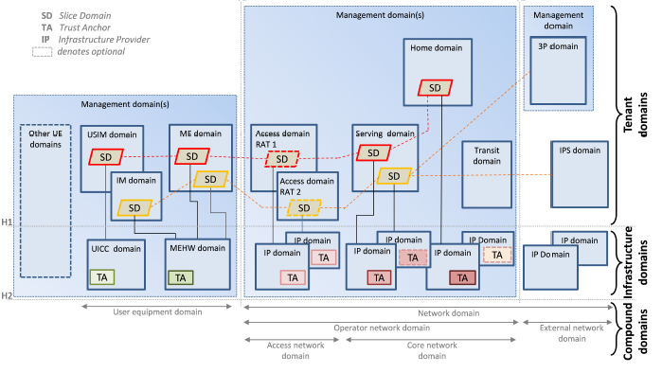
DOMAINS
A Security Architecture for 5G Networks
Courtesy : https://ieeexplore.ieee.org/document/2827419

Slide 8
DOMAINS (contd..)
A Security Architecture for 5G Networks
Infrastructure domains
On user equipment side,
Universal Integrated Circuit Card (UICC)
Mobile Equipment Hardware (MEHW)
On network side,
Infrastructure Provider (IP) domain
trust anchors(TA)

Slide 9
DOMAINS (contd..)
A Security Architecture for 5G Networks
Tenant domains
On user equipment side,
Mobile Equipment (ME)
Universal Subscriber Identity Module (USIM )
Identity Management (IM)

Slide 10
DOMAINS (contd..)
A Security Architecture for 5G Networks
On network side,
Access (A)
Serving (S)
Home (H)
Transit(T)
3rd Party (3P)
Internet Protocol Service (IPS)
Management (M)

Slide 11
DOMAINS (contd..)
Efficient and Consistent Flow Update for Software Defined Networks
Compound domain
On user equipment side,
User Equipment (UE) domain
On network side
Network domain (N)
Operator Network (OP)
External Network (EN)
Access Network (AN)
Core Network (CN)

Slide 12
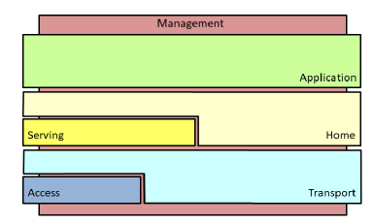
STRATA
A Security Architecture for 5G Networks
Application
Home
Serving
Transport
Access
Management
Courtesy : https://ieeexplore.ieee.org/document/2827419

Slide 13
SECURITY REALMS
A Security Architecture for 5G Networks
Access Network
Application
Management
User Equipment
Network
Infrastructure and Virtualisation

Slide 14
SECURITY CONTROL CLASSES
A Security Architecture for 5G Networks
Identity and Access Management
Authentication
Non- reputation
Confidentiality
Integrity

Slide 15
SECURITY CONTROL CLASSES(contd...)
A Security Architecture for 5G Networks
Availability
Privacy
Audit
Trust and Assurance
Compliance

Slide 16
ANALYSIS
A Security Architecture for 5G Networks
Backward Compatibility
Domains and strata corresponds to ones used in 3G and 4G
Flexibility and Adaptability
Allows definition of new domains, strata and security realms
Trust Relations
By observing interdependencies and requires interactions

Slide 17
ANALYSIS(Contd...)
A Security Architecture for 5G Networks
Virtualisation and Slicing
Virtualisation by defining infrastructure and tenant domains
Slicing through introduction of slice domains
Protocols and Network Functions
Definition of strata provide high level view of protocols
Security Control Points
Domains and slices provide boundaries

Slide 18
ANALYSIS(Contd...)
A Security Architecture for 5G Networks
Security Controls
Analysing which security controls required in a given security realm
Network Management
Management domain, management stratum and management security realm

Slide 19
USE CASES
A Security Architecture for 5G Networks
a ) Smart Cities and 5G
Large number of low cost IOT devices
Optimize electricity consumption and production
IOT devices are geographically distributed and can be mobile
5G technologies provide dedicated logical networks

Slide 20
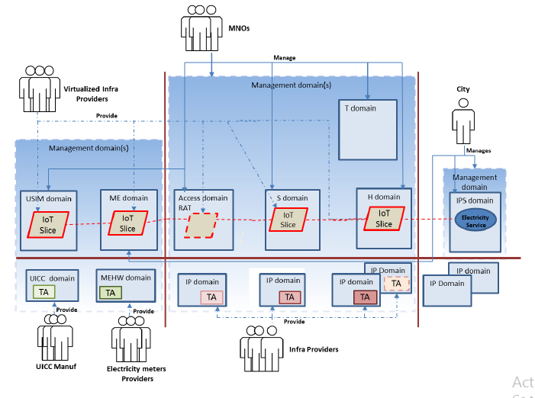
USE CASES(contd...)
A Security Architecture for 5G Networks
Courtesy : https://ieeexplore.ieee.org/document/2827419

Slide 21
USE CASES(contd...)
A Security Architecture for 5G Networks
Trust relations in Smart City Use case
City trusts MNOs to provide access control
City trusts MNOs to protect readings
Users trust cities and MNOs
MNO trust UICC manufactures

Slide 22
USE CASES(contd...)
A Security Architecture for 5G Networks
Mapping security realms to Security control classes
Access Network
Authentication, Identification and access control
Application
Identification and access control
Confidentiality and Integrity
Privacy

Slide 23
USE CASES(contd...)
UE
Trust and assurance
Management
Auditing
Trust and Assurance

Slide 24
USE CASES(contd...)
A Security Architecture for 5G Networks
Network
Authentication
Identification and Access Control
Infrastructure and Virtualisation
Availability
Trust and Assurance

Slide 25
USE CASES(contd...)
A Security Architecture for 5G Networks
b ) An SDN attack
Main threat is loss of connectivity
When SDN controllers gets overloaded
Affects function in transport and management strata
Hide the timing information

Slide 26
CONCLUSION
A Security Architecture for 5G Networks
5G networks will reuse and extend existing concepts
Security architecture upon concepts of domain and strata
Security realms captured security needs
Security control classes to satisfy security needs
Enables the capture of new models

Slide 27
REFERENCES
A Security Architecture for 5G Networks
P. K. Agyapong, M. Iwamura, D. Staehle, W. Kiess, and A. Benjebbour, ‘‘Design considerations for a 5G network architecture,’’ IEEE Commun. Mag., vol. 52, no. 11, pp. 65–75, Nov. 2014.
ITU-T. (2003). X.805: Security Architecture for Systems Providing end-to end Communications. [Online]. Available: https://www.itu.int/rec/T-RECX.805-200310-I/en
3GPP. (2008). TS 33.401: 3GPP System Architecture Evolution (SAE); Security Architecture. [Online]. Available: https://www.3gpp.org/ DynaReport/33401.html
5G-ENSURE. (2016). Deliverable D2.1: Use Cases. [Online]. Available: http://www.5gensure.eu/deliverables
3GPP. (2017). TS 33.899: Study on the Security Aspects of the Next Generation System. [Online]. Available: https://portal.3gpp.org/ desktopmodules/Specifications/SpecificationDetails.aspx?specificationId =3045

Slide 28
REFERENCES(Contd..)
A Security Architecture for 5G Networks
6. 3GPP. (2017). TS 22.261: 3GPP Service Requirements for the 5G System; Stage 1. [Online]. Available: http://www.3gpp.org/news-events/ 3gpp-news/1786-5g_reqs_sa1
Ericsson. (2017). Ericsson Mobility Report. [Online]. Available: https:// www.ericsson.com/assets/local/mobility-report/documents/2017/ ericsson-mobility-report-june-2017.pdf
5G Infrastructure Association. (2015). 5G and E-Health. [Online]. Available: https://5g-ppp.eu/wp-content/uploads/2016/02/5G-PPP-WhitePaper-on-eHealth-Vertical-Sector.pdf
5G Infrastructure Association. (2016). 5G Empowering Vertical Industries. [Online]. Available: https://5g-ppp.eu/wp-content/uploads/ 2016/02/BROCHURE_5PPP_BAT2_PL.pdf

Slide 29
A Security Architecture for 5G Networks
THANK YOU

